Slide 1
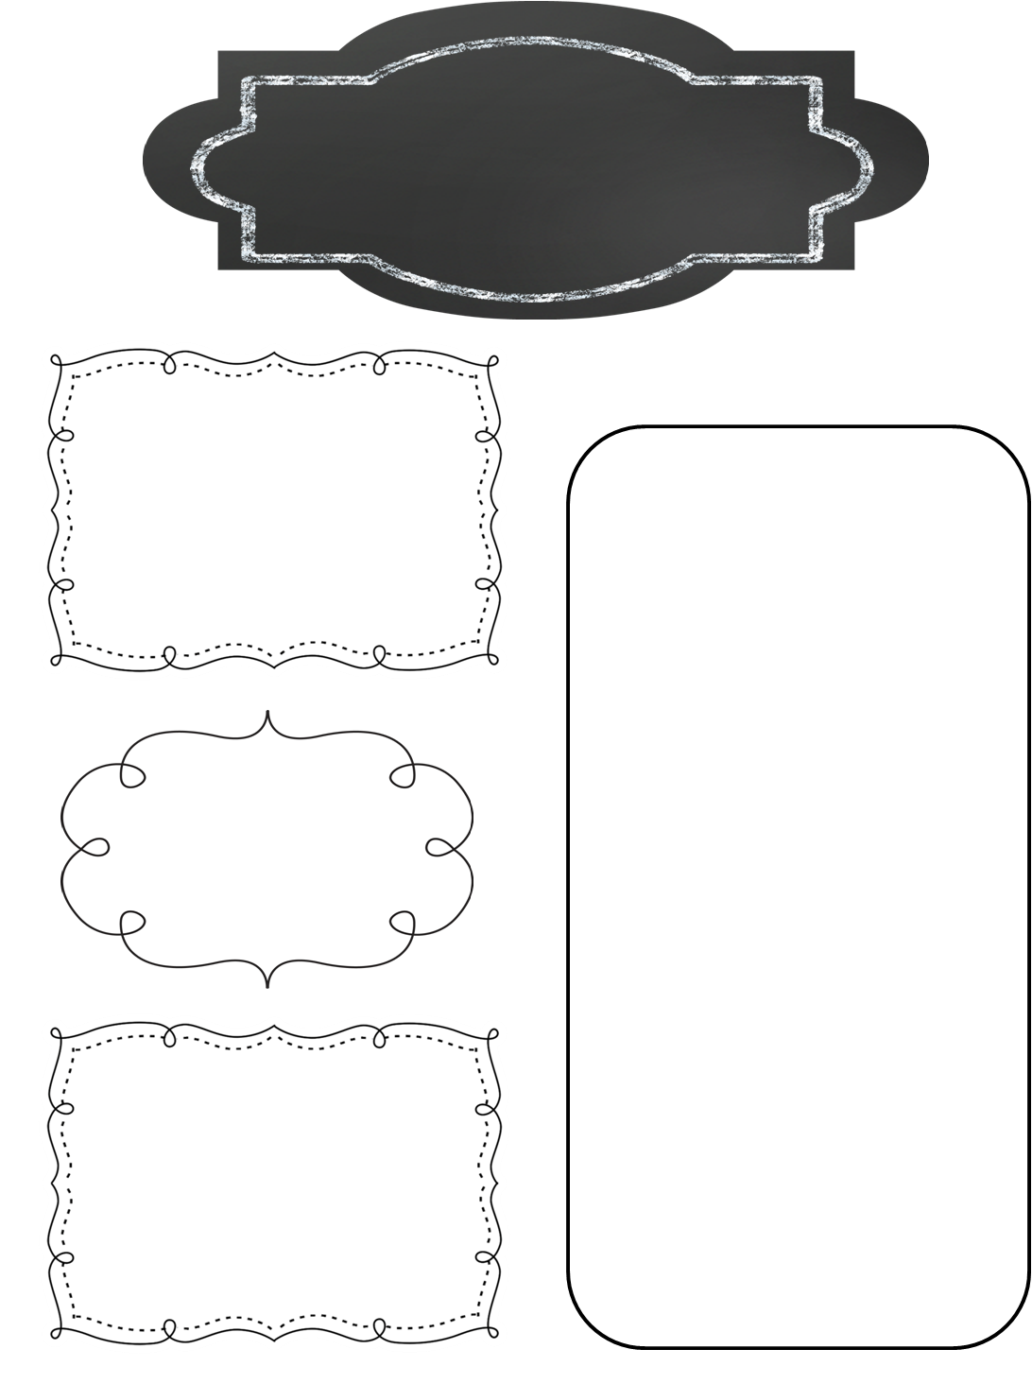
A Peek at This Week in…
Mrs. McFarland’s Class
Week of October 28th
Our Red Ribbon party will begin at 2p this Friday, November 1st. We will be doing several activities throughout the week about making good choices and staying drug free.
Reminders
Math (McFarland)
2-digit divisor division
Quiz on Friday over 2- digit divisor division
Reading (McFarland)
Please see the attached Focus Wall for vocab words, spelling words, and skills/ strategies for U2L#6.
Vocab/comprehension/ language assessment is Friday.
Please continue to work with your student on multiplication math facts especially. Go to my web page under “Math Resources” to find helpful sites to practice facts.
Spelling (McFarland)
Vowel and r sound
Test Friday
Upcoming Events
Language Arts/Writing (McFarland)
Monday, October 28-Friday, November 1: RED RIBBON WEEK
Mon: Pajamas Tues: Favorite sports team Wed: 5th wears green Thurs: bright/neon
Fri: wear all red
Wednesday, October 30th: Report cards go home
Sunday, November 3rd: Daylight savings time ends fall back 1 hour
Tuesday, November 5th: NMIS reading night 6:00-7:15p
Daily Proofreading
Verbs
Science/ Social Studies (Eldridge)
Science: N/A
Social Studies: Chapter 7, L#3; Boston Tea Party escape room

